Slide 1



0
1
Compiler Experiment 2
2
3
汇报人：杜喆（202130430379） 谭演锋（202130100456）
4
5
6
7

Slide 2
0
1
Use FLEX & YACC
1
Introduce myself
2
目录
3
Contents
2
Use C code
4
The content of the work
5
6
3
Comparisons between two methods
7
Excellent results

Slide 3
Preparations：

Slide 4
Flex+BISON
automatic Compiler
0
1
2
壹
3
——by 谭演锋——
4
——part 1——
5
6
7

Slide 5
Lexer&Context-Free Grammar:
The first step was to code the lexer file to take the stream of characters from the input programs and identify the tokens defined with the help of regular expressions. Next, the yacc file was created, which contained the context-free grammar that accepts a complete C program constituting headers, main function, variable declarations, and initializations, nested for loops, if-else constructs, and expressions of the form of binary arithmetic and unary operations. At this stage, the parser will accept a program with the correct structure and throw a syntax error if the input program is not derived from the Context-Free Grammar.
0
1
2
3
Compile the .l and .y and implement input1.c for testing in MAC:
4
lex lexer.l
yacc -d -v parser.y
gcc -ll -w y.tab.c
./a.out<input1.c
5
6
7

Slide 6
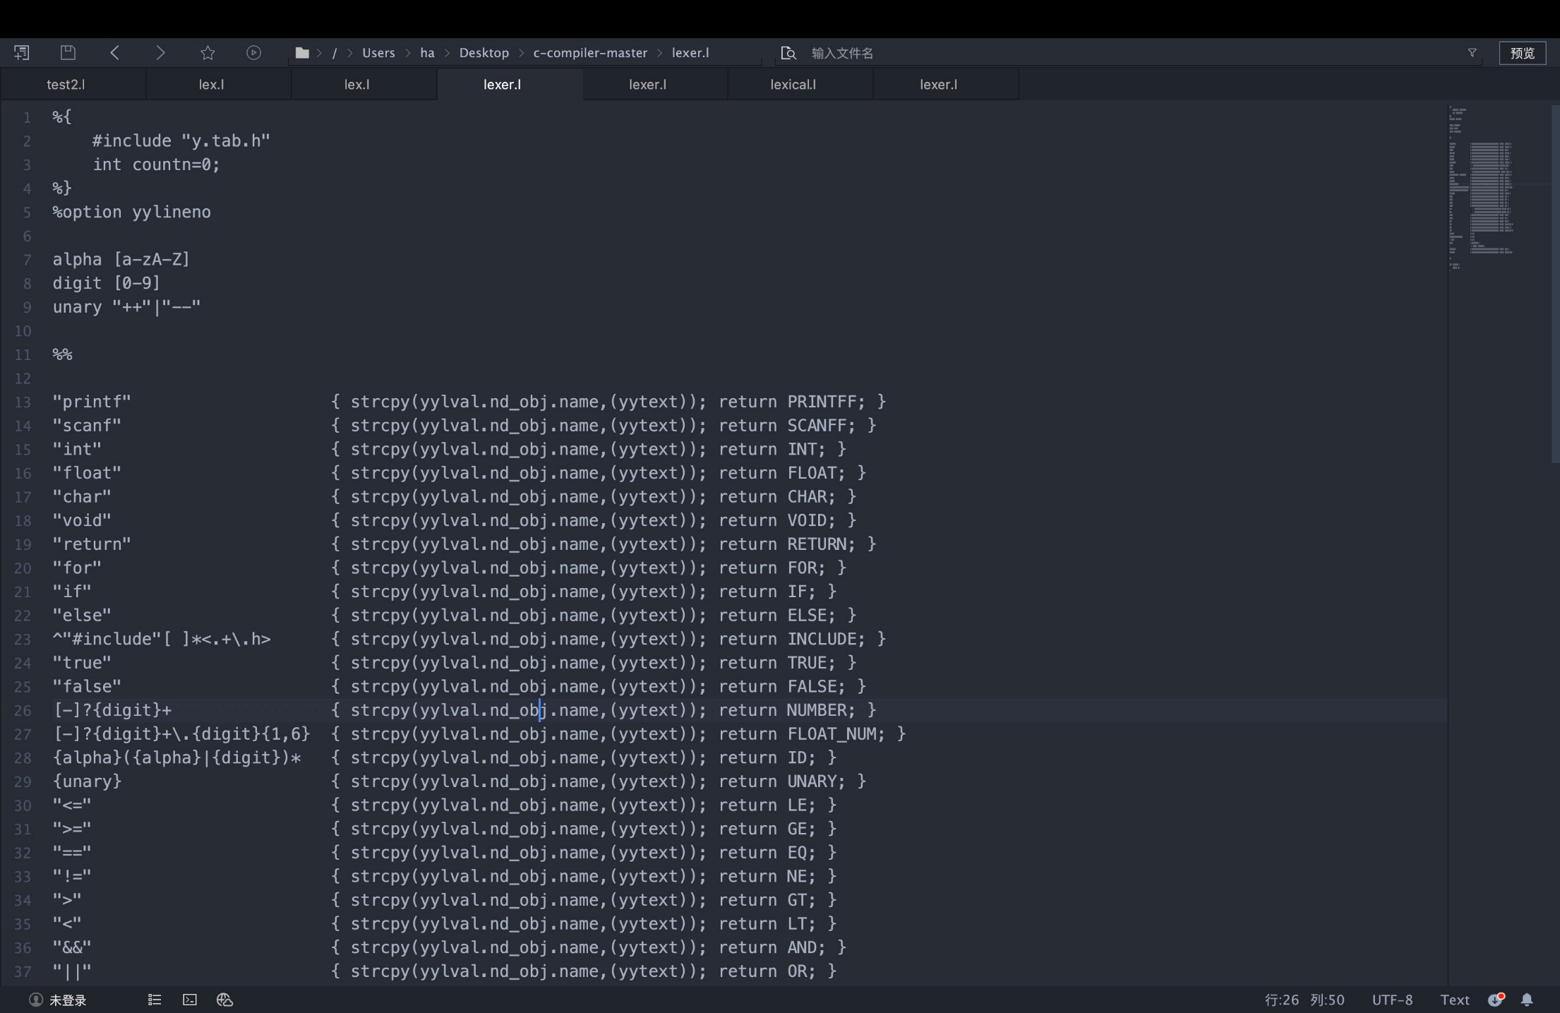
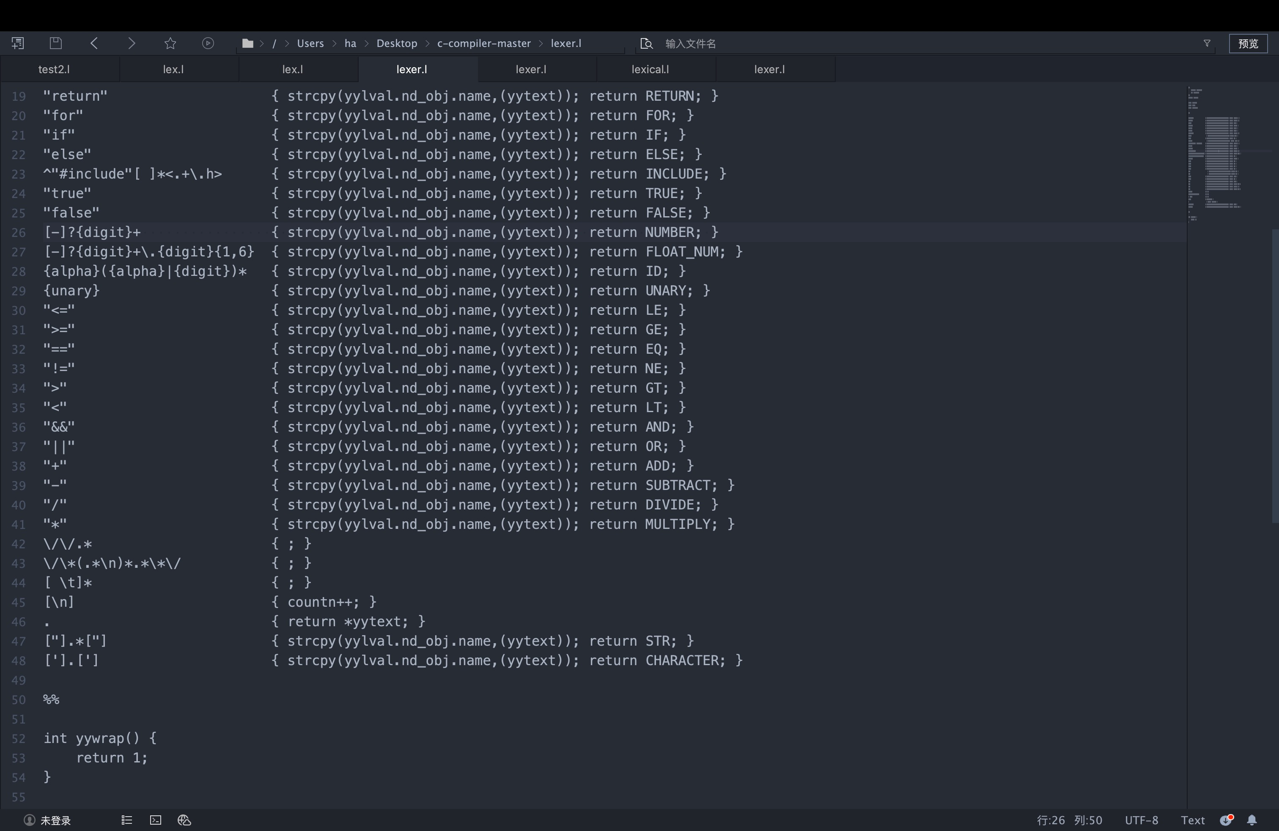
Lexer.l file:
0
1
2
3
4
5
6
7

Slide 7
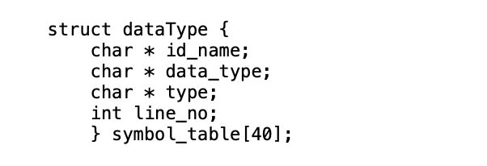


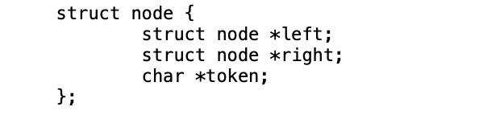
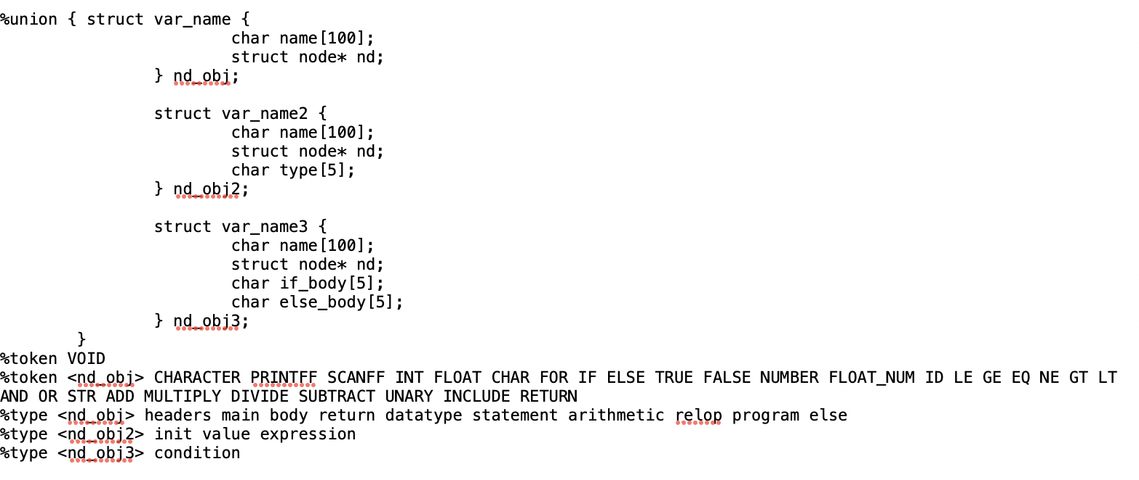
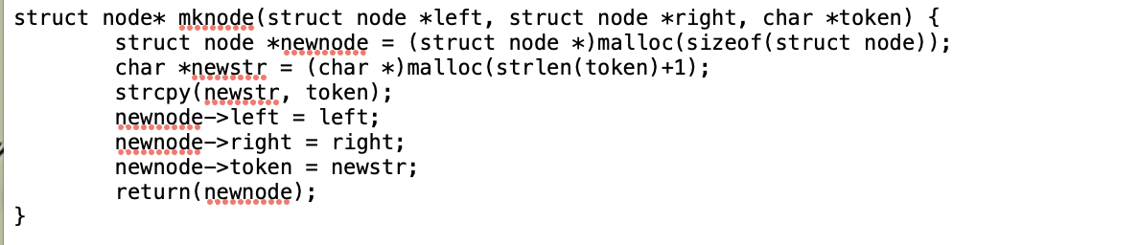
Data struct for bison:
0
1
2
3
4
5
6
Label is used to identify different block of the instruction,
Icg is used to stored the intermediate code, which will print in the final.
node is used to build Parse Tree
dataType is used to store the variable value and its type for the syntax analysis and semantic analysis.
Use the obj, obj2,obj3 to separate different types of token. if_body and else_body for the true address and the false address.
7

Slide 8
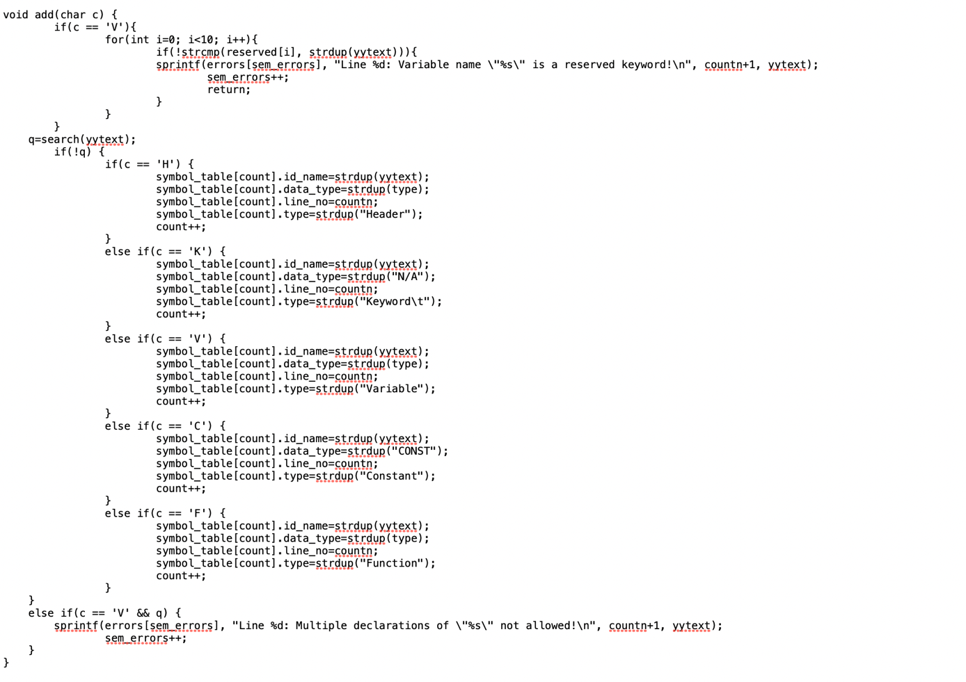
Semantic Analysis:
1. Variables cannot be redeclared. Since our compiler assumes a single scope, variables cannot be redeclared even within loops. For this check, the add function is changed to check if the symbol is present in the symbol table before inserting it. If the symbol is already present, and it is of the type variable, the user is attempting to redeclare it, and an error message is printed. It is also used for maintaining the symbol_table.
0
1
2
3
4
5
6
7

Slide 9
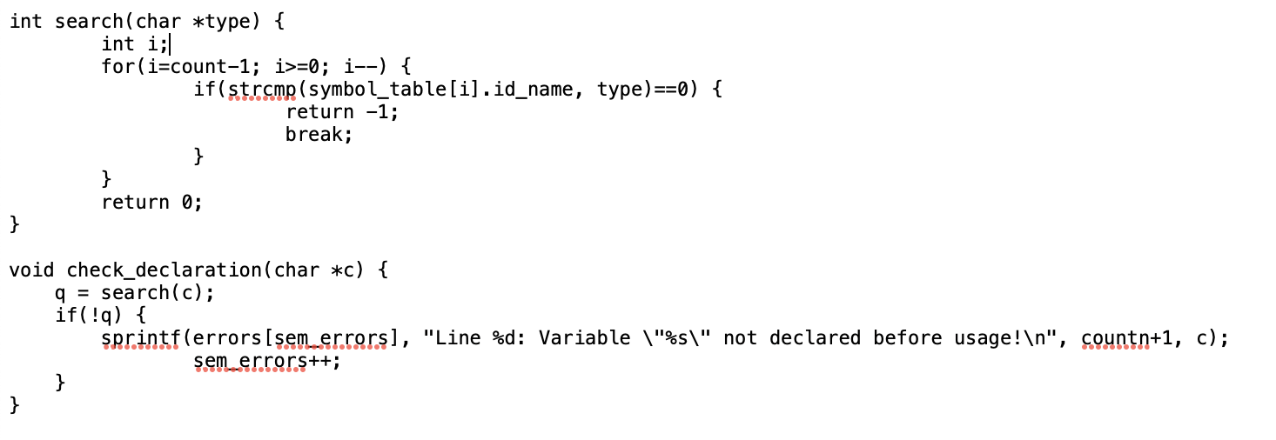
Semantic Analysis:
The semantic analyzer handles three types of static checks.
2. Variables should be declared before use. For this, we use the check_declaration function that checks if the identifier passed as a parameter is present in the symbol table. If it is not, an informative error message is printed. The check declaration function is called every time an identifier is encountered in a statement apart from a declarative statement.
0
1
2
3
4
5
6
7

Slide 10
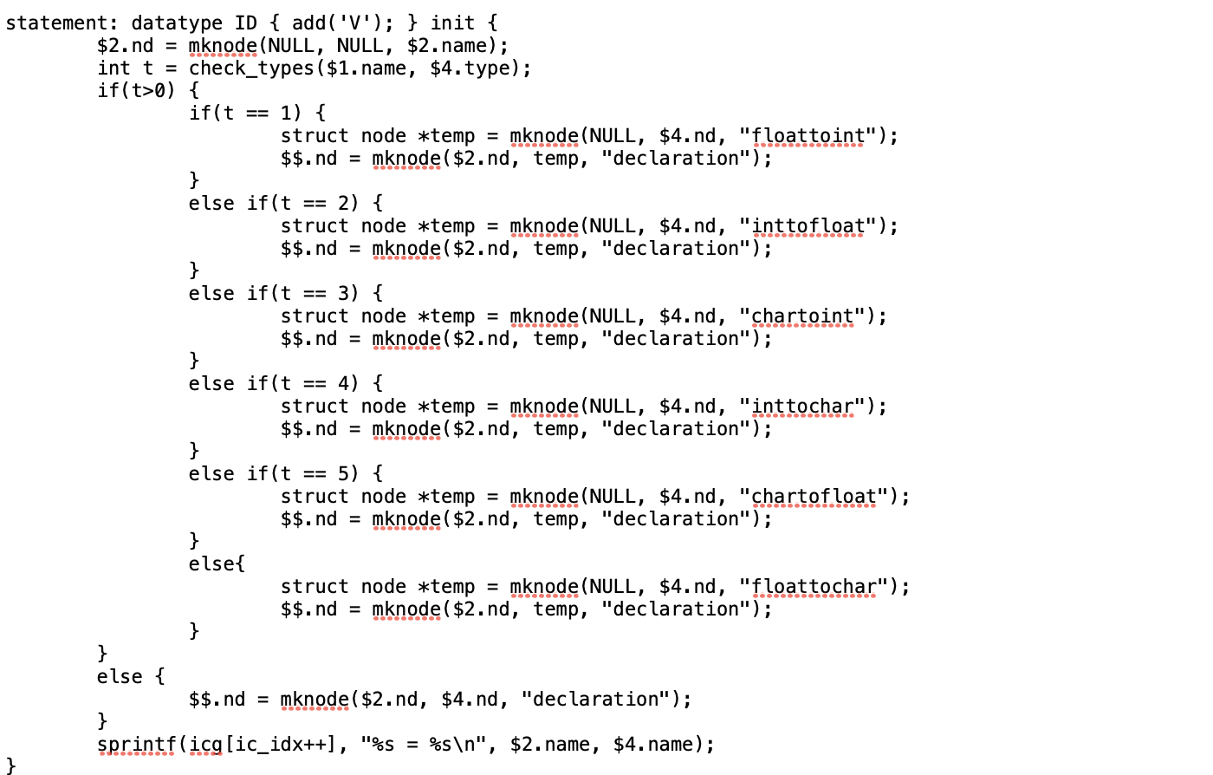
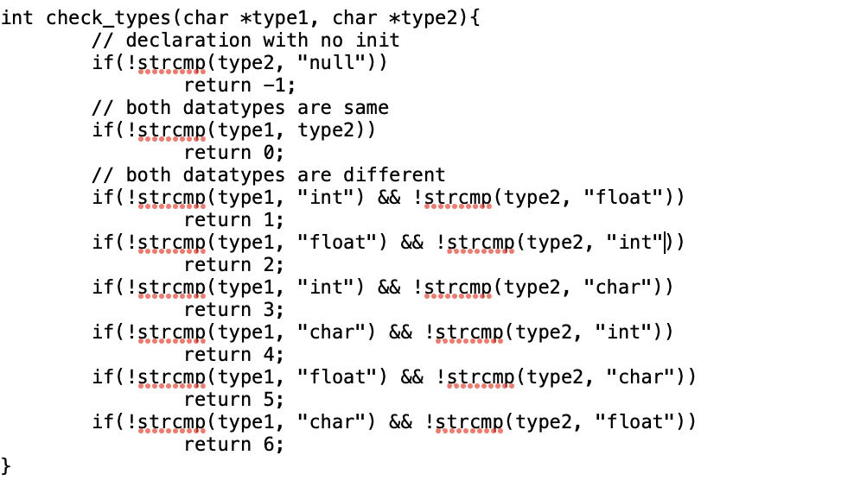
Semantic Analysis:
3. Pertains to type checking of variables in an arithmetic expression. For this, the check_types function is used, which takes the types of both variables as input. If the types match, nothing is done. If one variable needs to be converted to another type, the corresponding type conversion node is inserted in the syntax tree (inttofloat or floattoint). The type field was added to the struct representing value and expression tokens to keep track of the type of the compound expressions that are not present in the symbol table. The output of this phase is the annotated syntax tree.
0
1
2
3
4
5
6
7

Slide 11
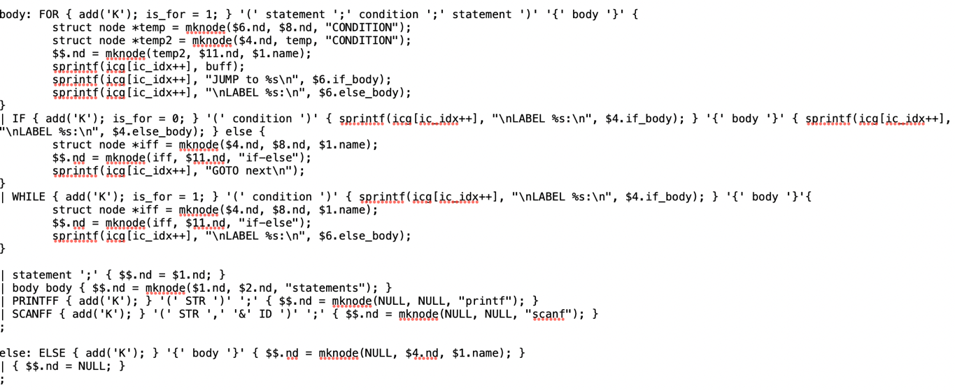
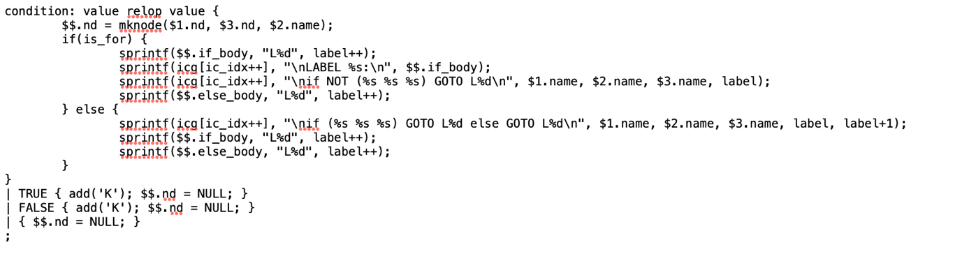
Intermediate Code Generation , Control statement and relation operation:
For intermediate code generation, the three address code representation was used. Is_for is used to judge the control statement. We use sprint to serve as the “emit” function that generate the triples. The triples(Intermediate Code) will be stored in the “icg” for the finaly output.We use the if_body and else_body for the control statement as the true address and the false address of the control statement. We backpatch the address each time when we make a reduction of some terminal such as “)” or “;”. Therefore, we do not need the help of the E to help us remember where the address is.
0
1
2
3
4
5
6
7

Slide 12
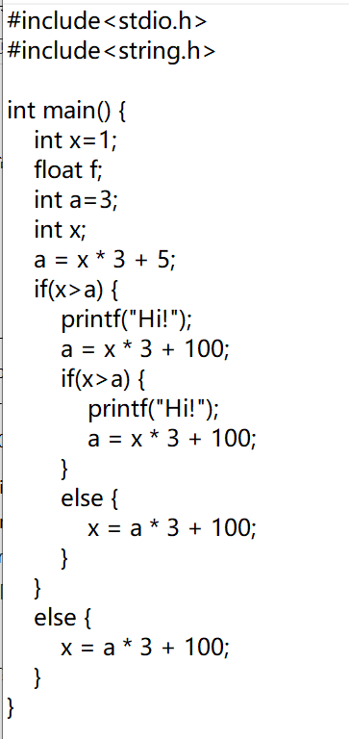
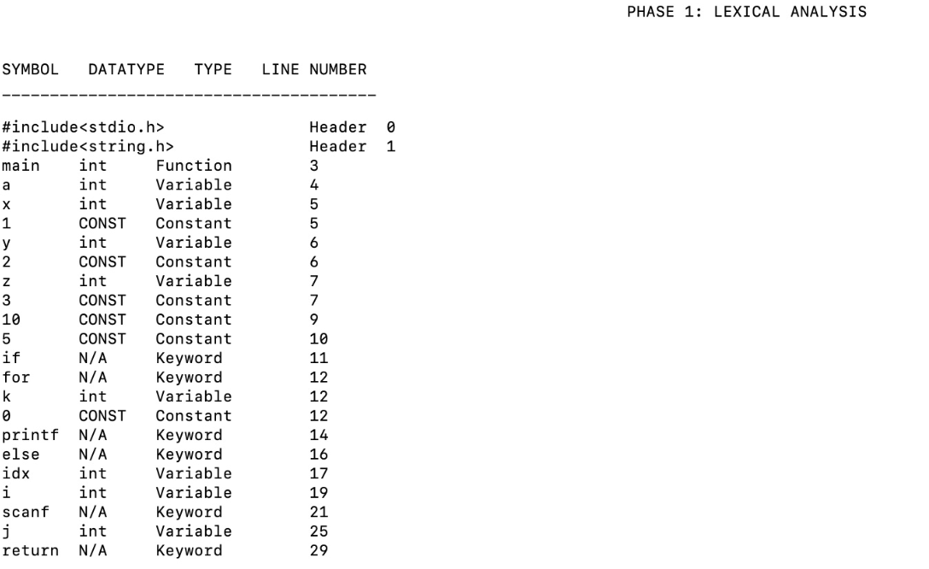
Examples:
Lexical Analysis:
0
1
2
3
4
5
6
7

Slide 13
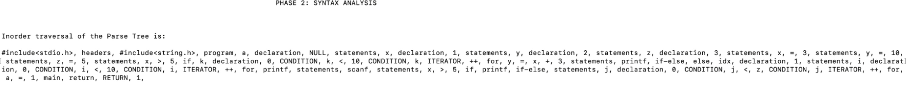
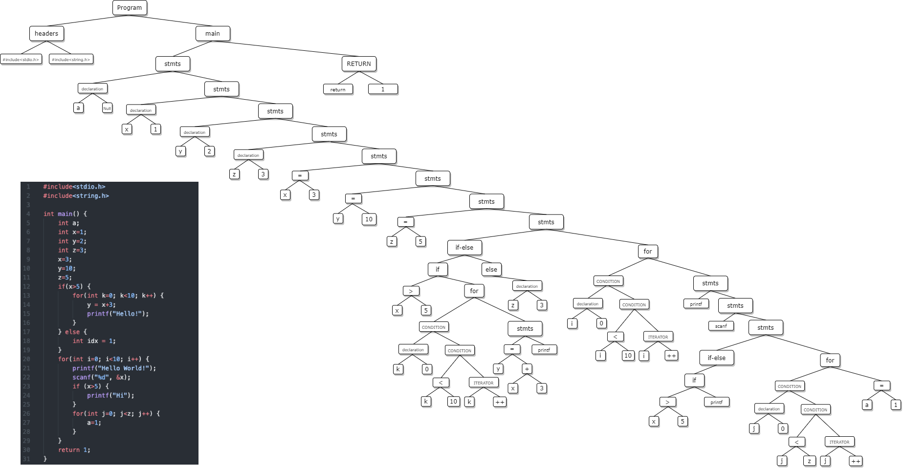
Printing Parse Tree Inorder
0
1
2
Visualising Parse Tree Inorder:
3
4
5
6
7

Slide 14
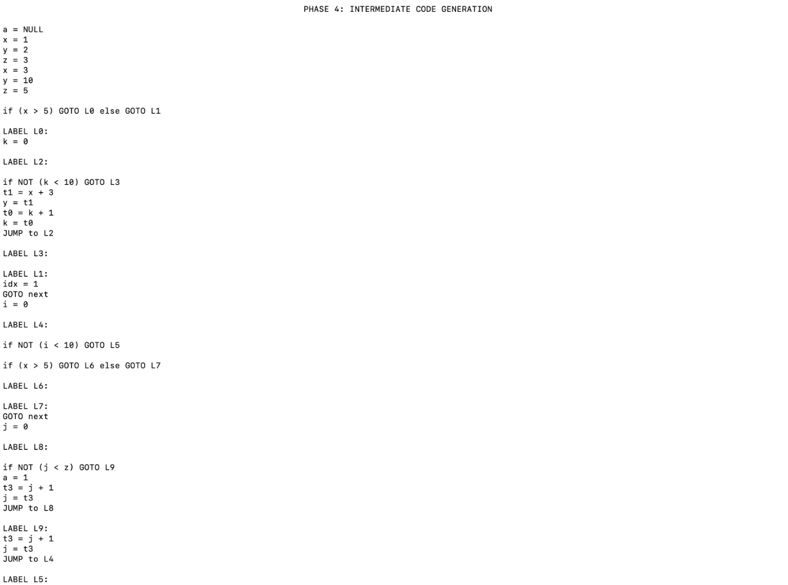
Semantic Phase
0
1
Intermediate Code Generation
2
3
4
5
6
7

Slide 15
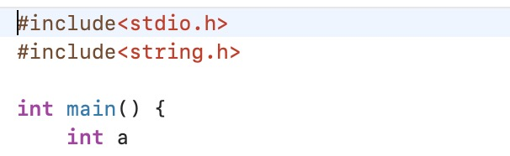
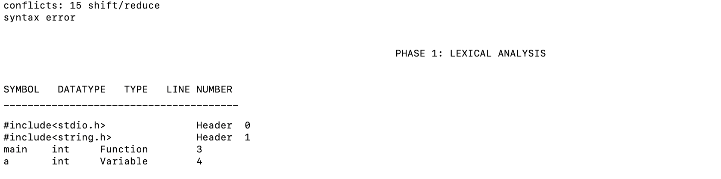
Syntax error
0
1
2
3
4
5
6
7

Slide 16
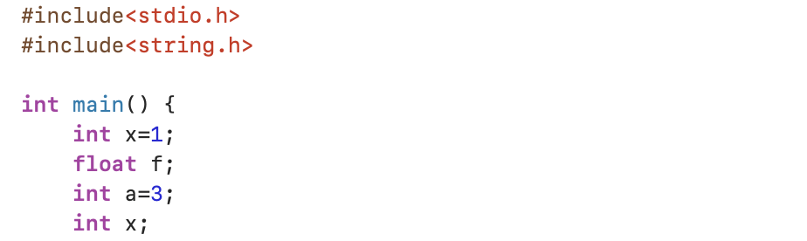
Semantic error
0
1
2
3
4
5
6
7

Slide 17
0
Manual Implementation
1
2
贰
3
——by 杜喆——
4
——工作内容——
5
6
7

Slide 18
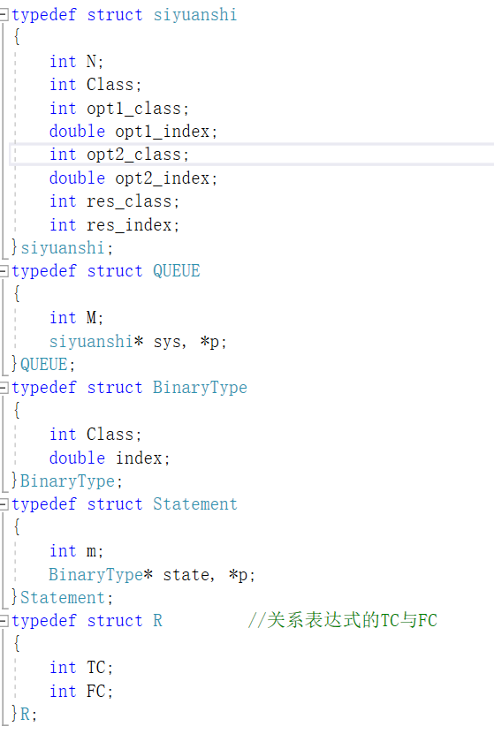
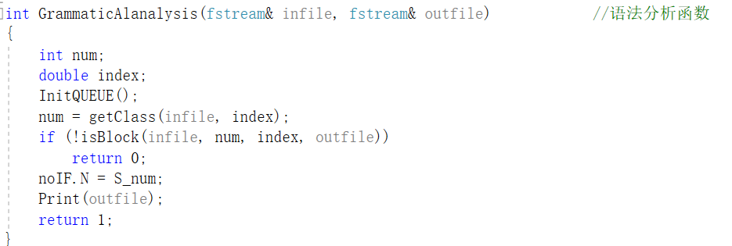
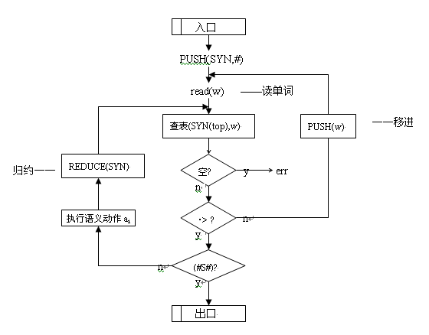
The entrance of parsing and semantic analysis
Define some tool structure help for analysis

Slide 19
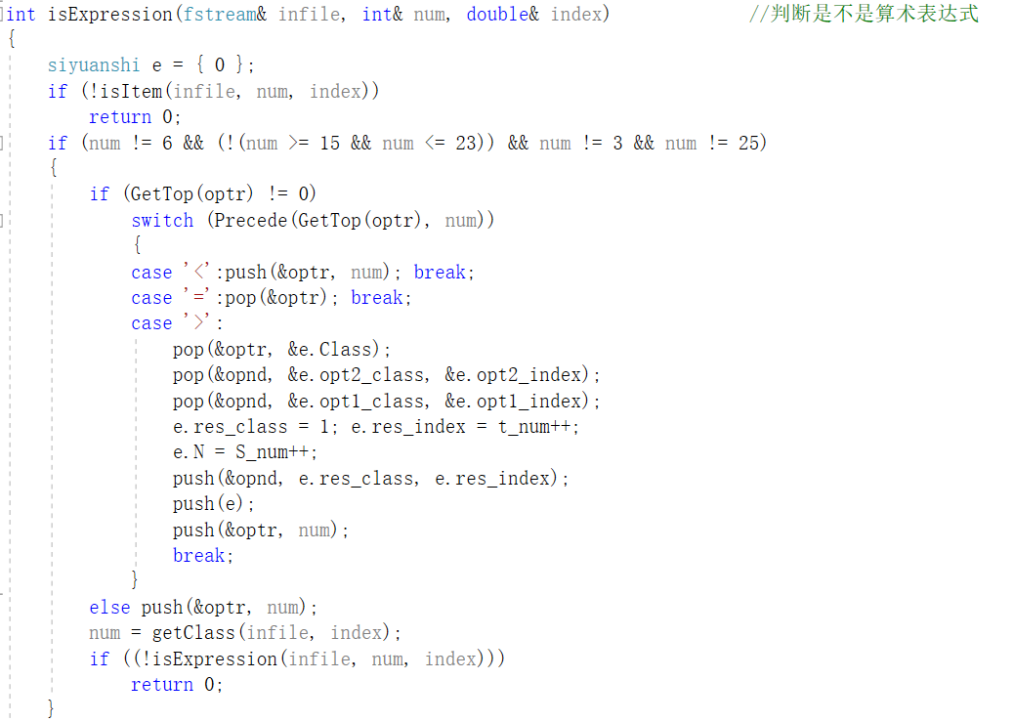
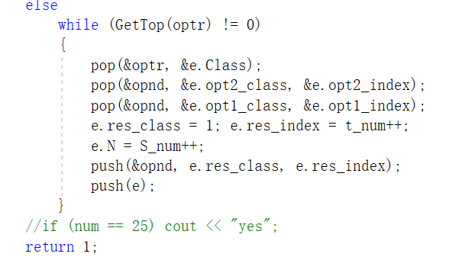
Arithmetic expression part:

Slide 20
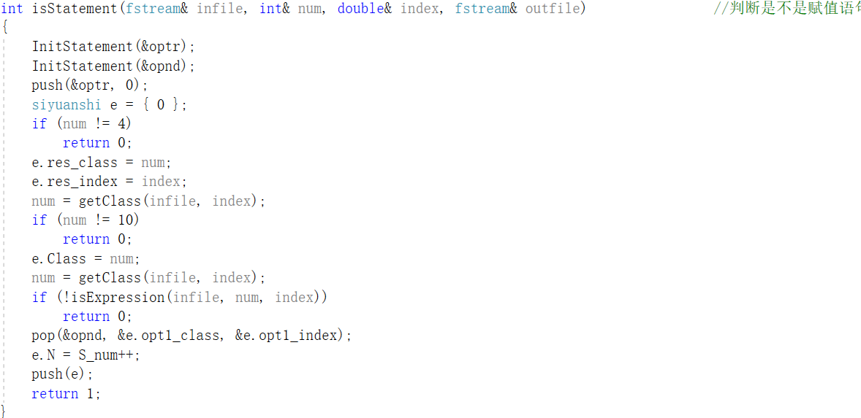
Assignment state part
First build the operator stack and arithmetic operator stack. Each scan encounters an operator and pushes it into the stack. If an operator is encountered, if the current stack is empty, it is pushed into the stack. Otherwise, it is compared with the priority of the operator on the top of the stack. If it is less than or equal to its priority, the symbol on the top of the stack is popped and four The quaternion is generated, and then the quaternary is pushed into the quaternary queue, and then continues to be compared with the top element of the stack until its priority is greater than its priority or the stack is empty.

Slide 21
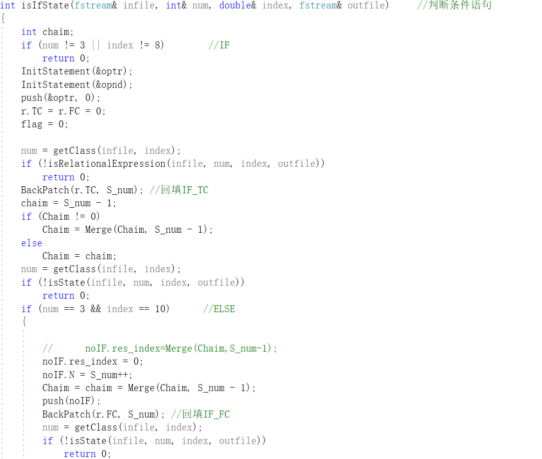
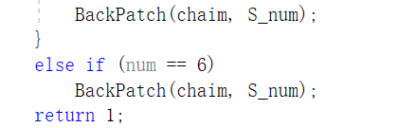
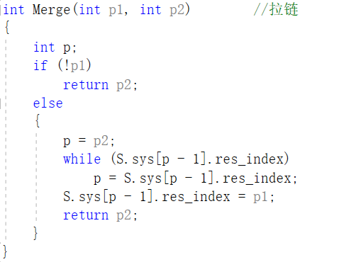
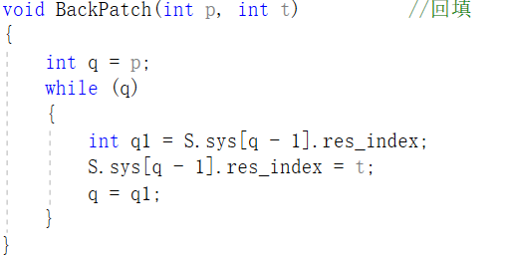
“if” statement part
When judging the Boolean expression, let the operator and the operator push the stack first, and assign the transition number to null first.
Wait until the part after the if then is scanned to determine the sequence number by generating its quaternion, and then look up the queue to backfill the sequence number.
The specific structure of the function:

Slide 22
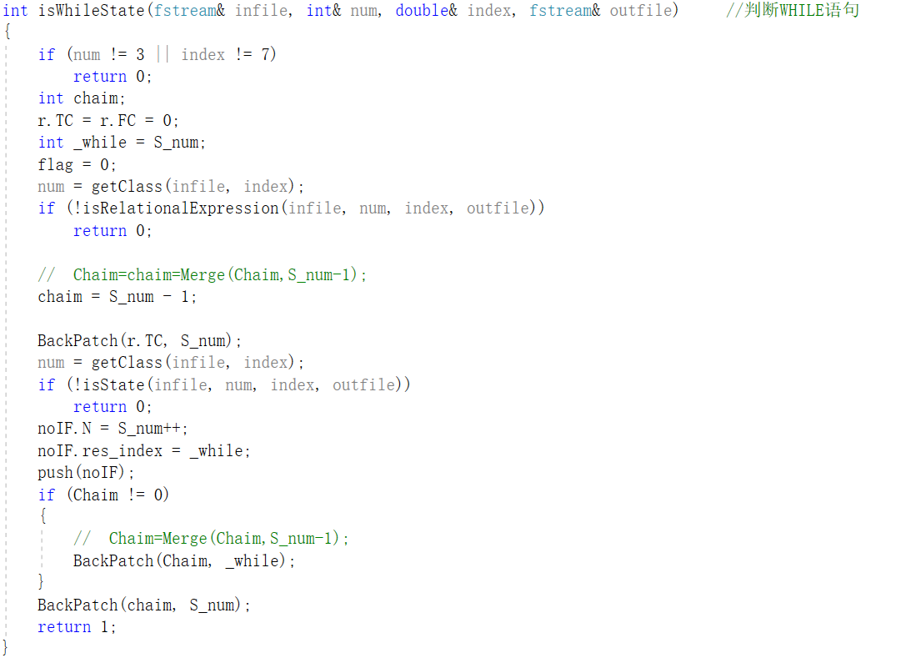
“While” state part

Slide 23
0
Comparisons between two methods
1
2
叁
3
4
——优秀成果——
5
6
7

Slide 24
Maintaining a Yacc-driven grammar is often easier than hand-written grammars, and you can benefit from the automation that Yacc provides.
If you write in a right way of the definition of Yacc, then you can not meet some weird bugs that are hard to fixed.
Yacc is inflexible in some ways: good error handling is hard (basically, its algorithm is only defined to parse the correct string correctly, otherwise, all bets are off; this is GCC's move to a handwritten parser One of the reasons) context dependencies are hard to express, whereas with handwritten recursive descent parsers we can simply add an argument to the function. Also, we noticed that lex/yacc object code is often larger than handwritten recursive descent parsers ( source code tends to be the other way around).
Yacc some times meet different problem when we use the instruction “bison” and gcc to make a executable file.

